Slide 2
Improve the experience for current and future pilots Invite more people to join general aviation Inspire more pilots to stay active and engaged
Notes:
The mission of the You Can Fly program is to get people flying and keep them flying.

Slide 3
Notes:
You Can Fly is made up of four distinct initiatives, each designed for a different stage of a pilot’s journey.
The High School initiative provides a four-year science and math based curriculum to help students discover and prepare for careers in aviation and aerospace.
The Flight Training initiative is aimed at helping more of the people who start flight training complete their training and earn a pilot certificate.
The Flying Clubs initiative helps create and support flying clubs to give pilots affordable access to aircraft and a community of their peers.
The Rusty Pilots initiative makes it easy to get back into flying after an absence. Many people who return to flying through the Rusty Pilots initiative have been out of flying for a decade or more.

Slide 4
AOPA High School Aviation STEM Curriculum
Three career and technical education pathways-pilot, UAS, aerospace engineering
Four year program
Industry credential in each pathway
Pilot FAA Private Pilot written
UAS FAA Part 107 Commercial Drone Pilot written Aerospace Engineering 3-D modeling software test
9th grade field test in progress
29 schools, +700 students
Notes:
Curriculum is a major part of the high school initiative, and probably the part with the most potential to make a difference.
It is designed for 9th through 12th graders and offers three different pathways, each leading to an industry-recognized certification or test.
The three pathways are pilot, drones or unmanned aerial systems, and aerospace engineering,
The 9th grade courses have been in field testing during the past year and will be available free of charge to any U.S. public or private high school beginning in the next (2018-2019) school year.
Tenth grade courses are now in development and a new grade level will be released each year until all four years are completed.
​No other organization has stepped up to meet this challenge on a national scale

Slide 5
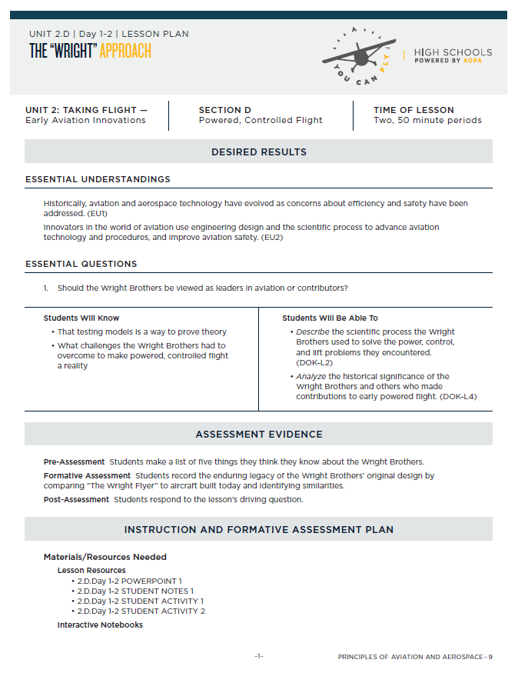
Lesson Resources
Lesson Plans
PowerPoints
Teacher Notes
Student Notes
Student Activities
Teaching Aids
Student Assessments
Student Projects
Notes:
Lessons are aligned to U.S. federal education standards
Resources Include lesson plans, presentations, student activities, and student assessments
Includes video clips, projects, links to extend learning
Suggests materials for activities that are low cost
AOPA provides three-day professional development workshops for teachers to help them gain a better understanding of the subject matter and course structure

Slide 6
The Challenge
Part 61 flight schools struggling with resources
Low CFI experience, high CFI turnover
Lack of business management experience and tools
Struggle to create a customer-focused experience
High student dropout rates
We must improve the value proposition and customer experience.
Notes:
The Flight Training initiative is designed to help schools the kind of customer experience that keeps students coming back
We’re working with aFlight Training Advisory Board
A dozen schools of various sizes and levels of success, located all across the country
Validated what we’ve observed, will be helping us test throughout the process

Slide 7
Solutions Through Technology and Training
Adaptive curriculum
Individualized curriculum that adjusts to student performance
Transparency, Predictability, Accountability
Integrated business tools
Many schools today cobble systems together
Need comprehensive suite that “talks” (scheduling, invoicing, lead generation, CRM
Business training
Flight school owners and employees need to learn how to deliver great experiences.
Notes:
We need a better way to deliver training...
AOPA is building an app that will deliver an individualized curriculum based on student performance
We are building and partnering to deliver integrated business support tools to help schools run their businesses more efficiently
We are developing training to help schools and CFIs deliver great customer experiences.
Training programs will be offered at You Can Fly Academy and virtually

Slide 8
Fly more, Pay less
We’ve helped start +65 new clubs!
30 in 2017!
Flying Club Network— +800 clubs
Flying Club Finder
Online resource library
Only association with free resources dedicated to building and maintaining clubs
Notes:
The Flying Club initiative is helping pilots start and grow flying clubs
More than 800 clubs are part of the Flying Club Network
AOPA Ambassadors based around U.S. work directly with pilots who want to start clubs
Ambassadors help with everything from developing bylaws and choosing an organizational structure to finding airplanes

Slide 9
Bringing lapsed pilots back
BasicMed has generated even more interest
3-hr seminar with signoff toward ground training for flight review
37% of truly rusty participants report completing a flight review
+250 seminars with more than 7,500 attendees in 2017
More than 4,600 pilots back in the air!
Notes:
Rusty Pilots provides free seminars designed to help pilots who haven’t flown for some time get recurrent
The seminars cover the topics required for a flight review
Participants get a signoff for 3 hours of ground instruction
Events are held at flight schools so participants can easily sign up for additional instruction
In 2018, we’ll celebrate getting our 5,000th pilot back in the air

Slide 10
You Can Fly Academy
ASI
ASI seminars/education
Video production
Podcast recording
Internal Use
Safety stand-downs
All hands meetings
Benefits briefings
ASN Board of Advisors meeting
Industry Meetings
Air Care Alliance annual meeting
2018 RedBird Migration
You Can Fly
Teacher professional development (in-person and virtual)
High School Steering Committee meetings
Flight Training Advisory Board meetings (in-person and virtual)
Train-the-Trainer CFI development
Adaptive curriculum beta testing
Flight school customer service training
Flying club boot camps
Rusty Pilot seminars
Distance learning for all initiatives
Notes:
The You Can Fly Academy is a source and destination for aviation learning
Located next to headquarters building in Frederick, MD
Space includes simulators, briefing rooms, classrooms, an auditorium and more
Academy will host events, training, webinars, seminars, and more

Slide 11
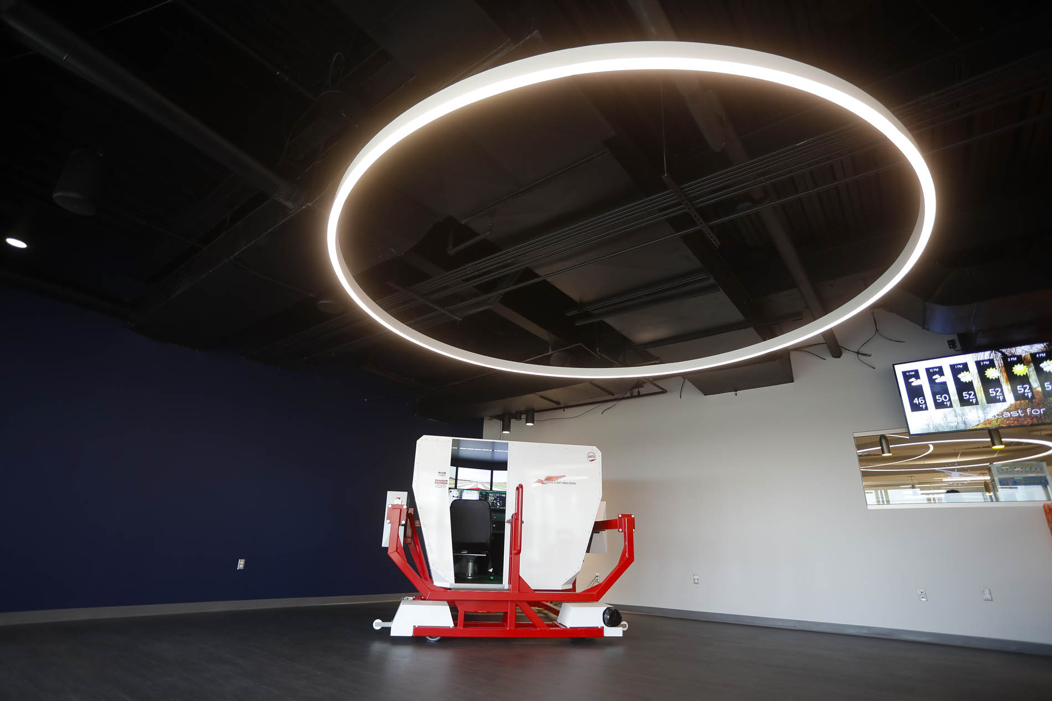
You Can Fly Academy
Notes:
Redbird full motion simulator in Academy. Expect to add two more simulators in 2018.

Slide 12
You Can Fly Academy
Notes:
Briefing rooms in the Academy. Equipped with large screens, computers, and other technology.

Slide 13
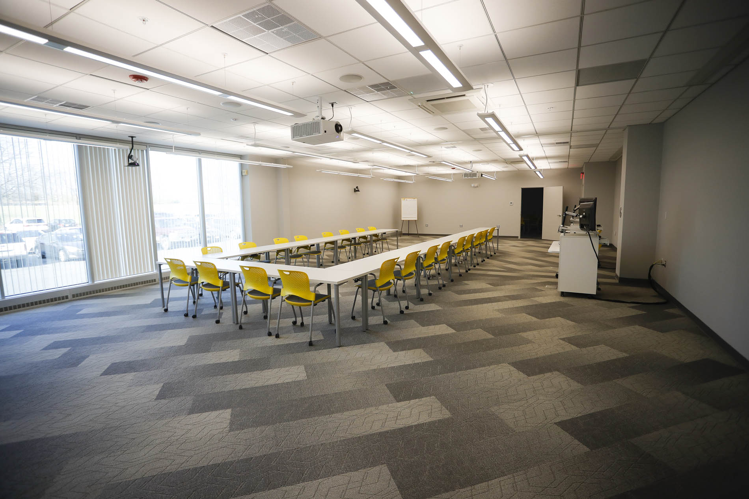
You Can Fly Academy
Notes:
Academy classroom, equipped with large screens, projectors, advanced audio, computers, and other technology

Slide 14
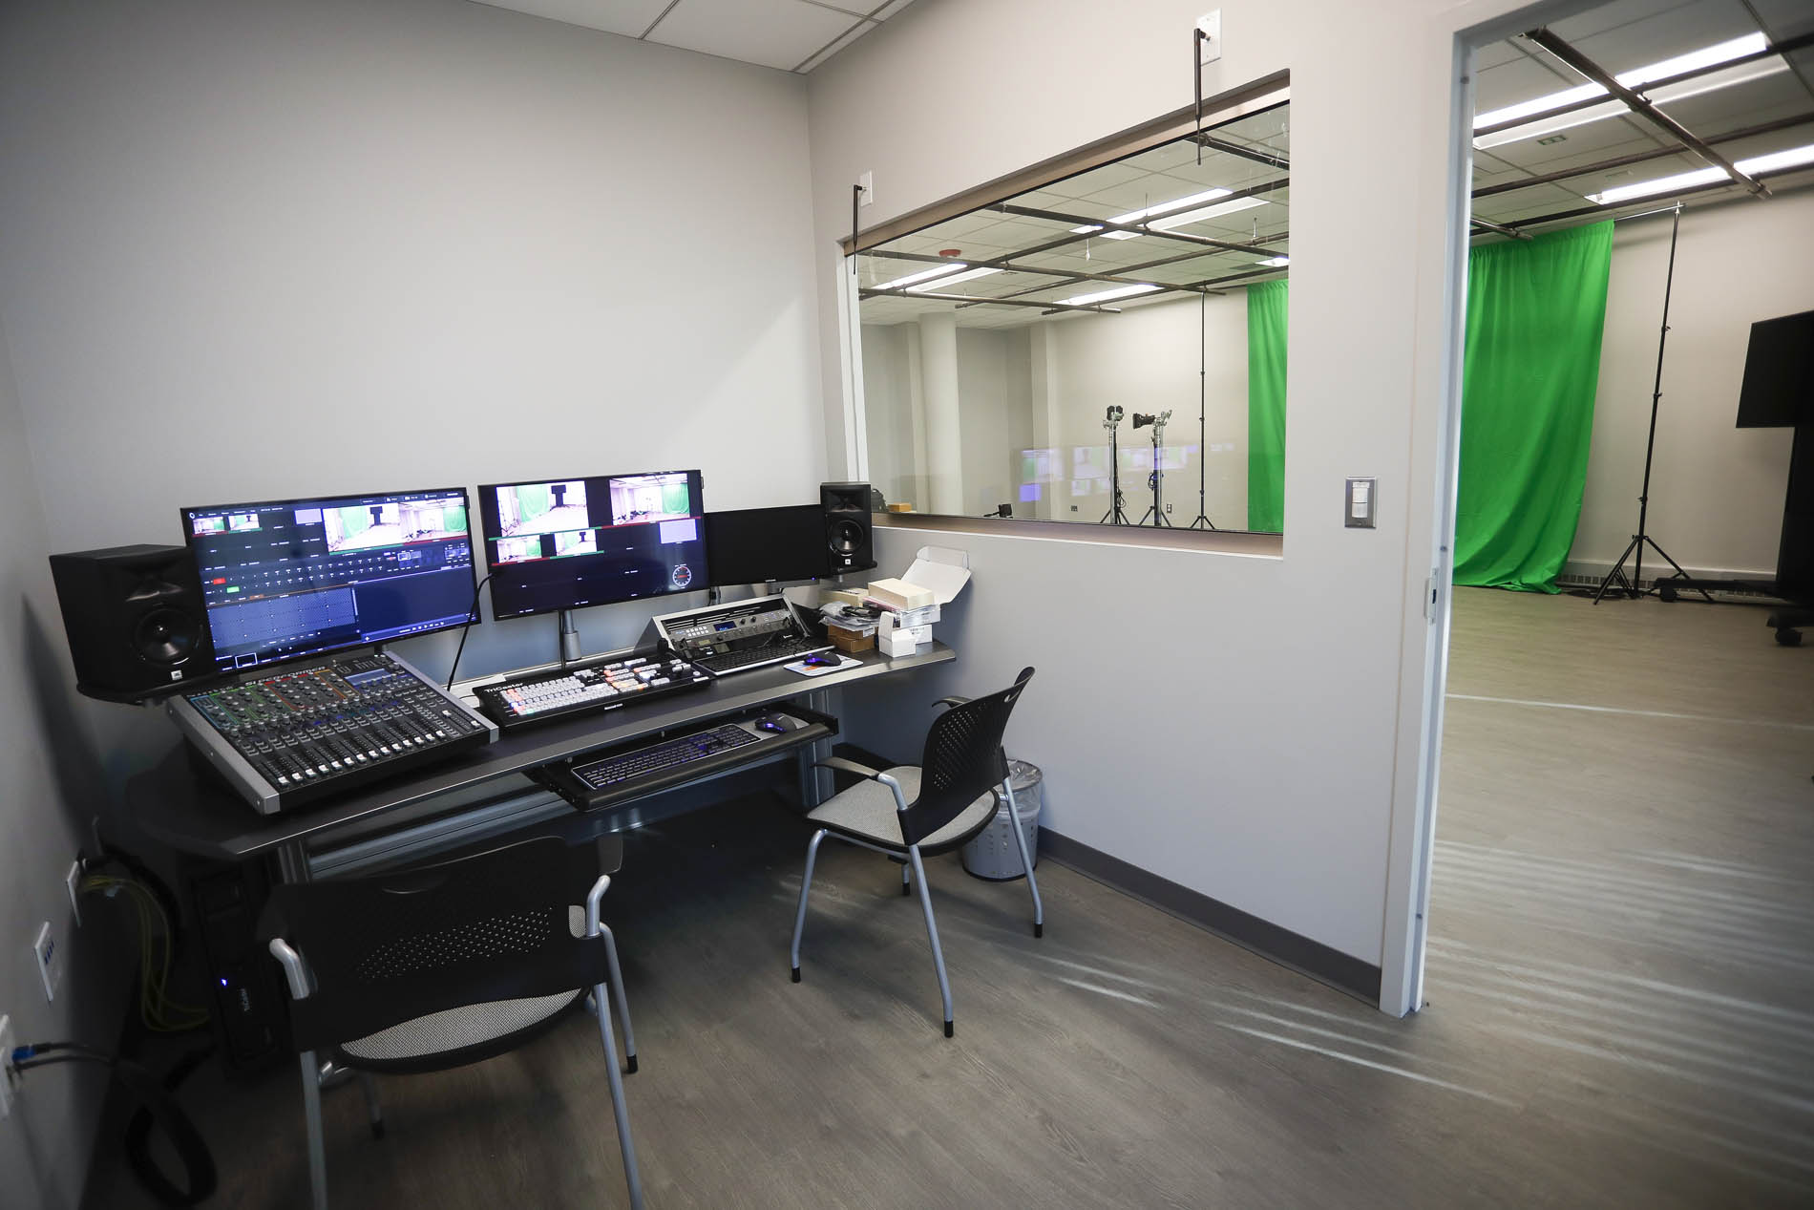
You Can Fly Academy
Notes:
Academy studio, designed to produce broadcast quality video, webinars, and more.

Slide 15
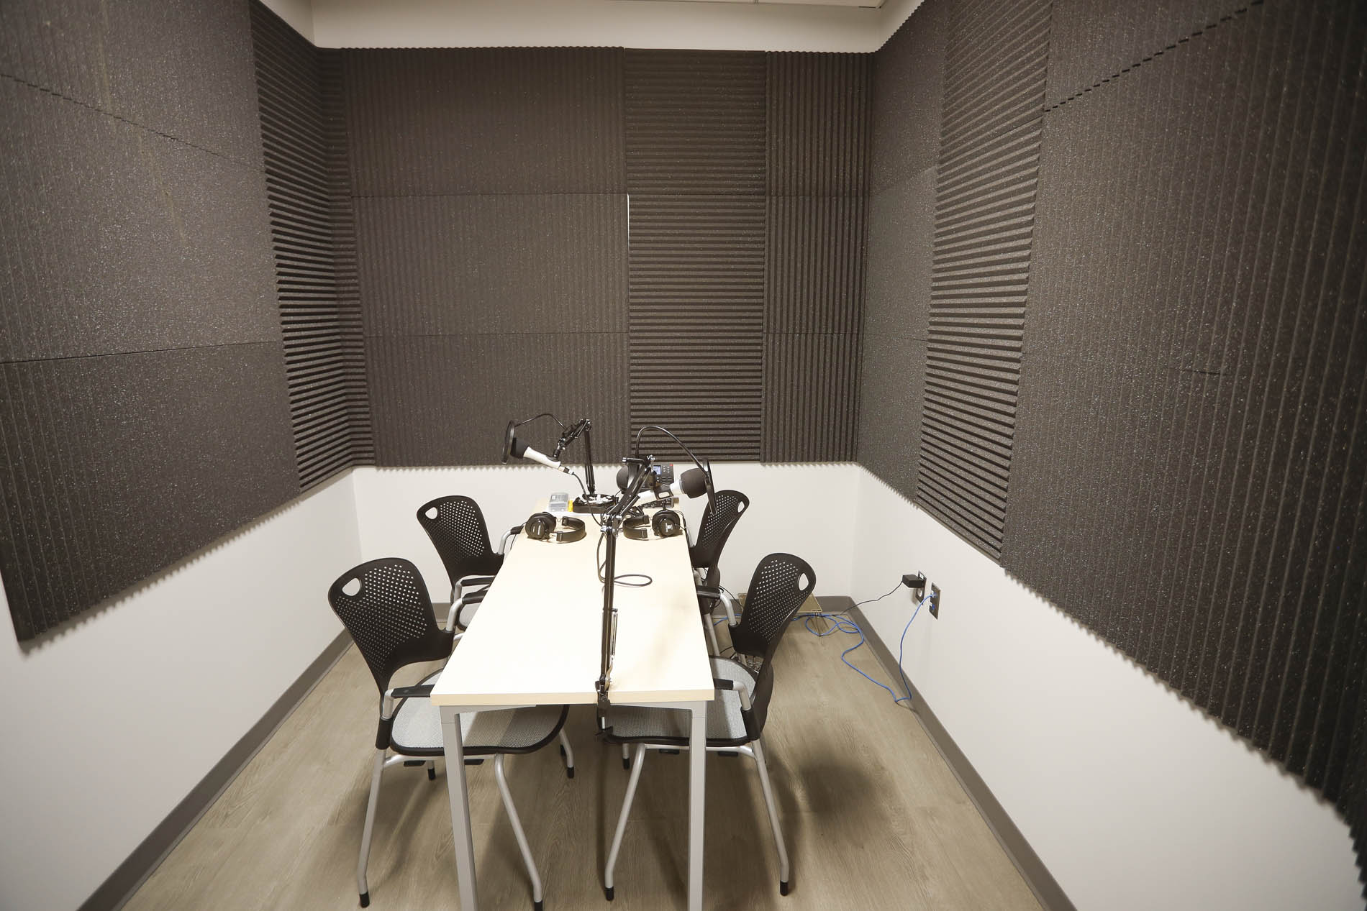
You Can Fly Academy
Notes:
Academy sound studio for recording sound bites, interviews, podcasts, and other high quality audio.

